Slide 1

PUBLIC HEALTH CAMPAIGN AWARENESS
Presented by,
m.dhivya,
s.nitisri,
c.rethanya,
s.thrishna.

Slide 2
MODULES
1)SPLITTING THE TRAINING AND TESTING DATA
2) APPLYING SUPPORT VECTOR MACHINES
3)CREATING DASHBOARD USING IBM COGNOS
4)CREATING REPORT USING IBM COGNOS
5)STATISTICAL TESTS USING TREEMAP

Slide 3
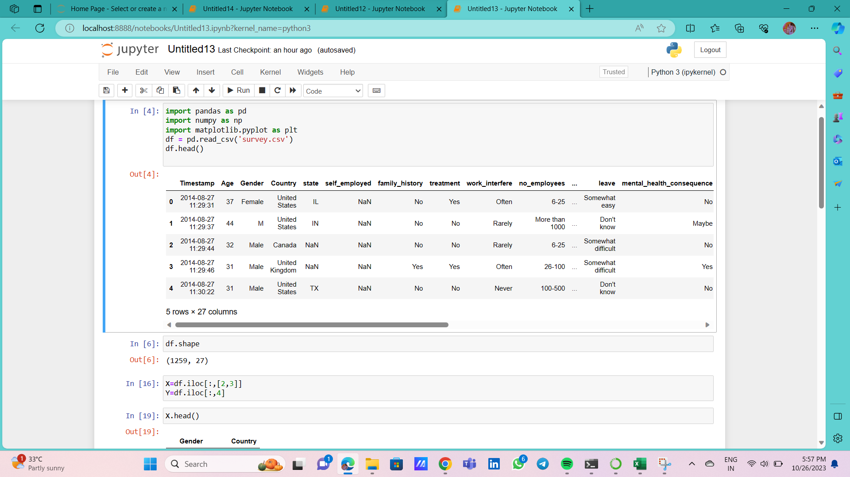
Step 1:SPLITTING THE TESTING AND TRAINING DATA

Slide 4
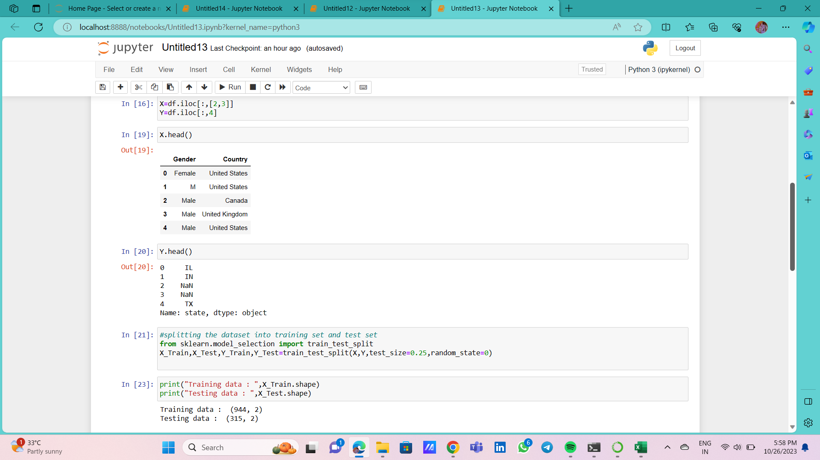

Slide 5
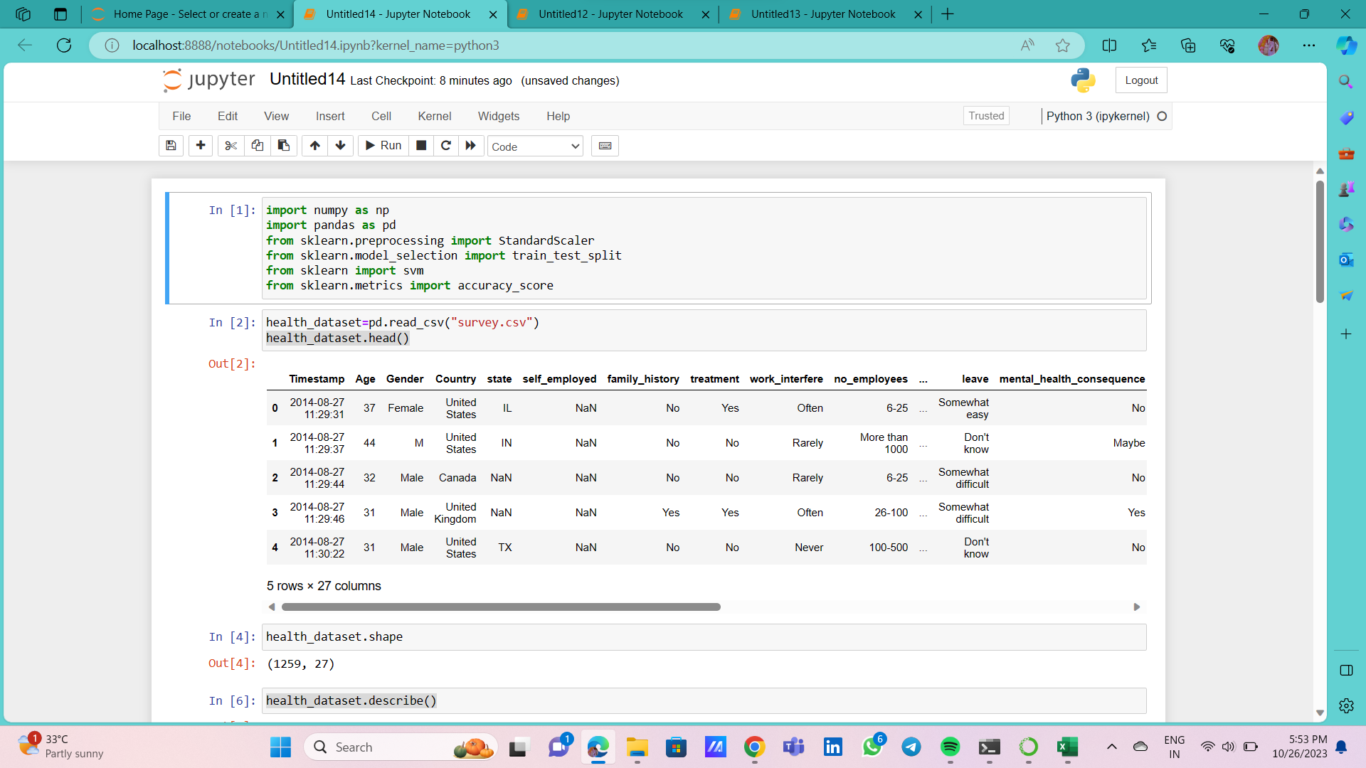
Step 2:Applying Support vector Machines and loss calculation

Slide 6
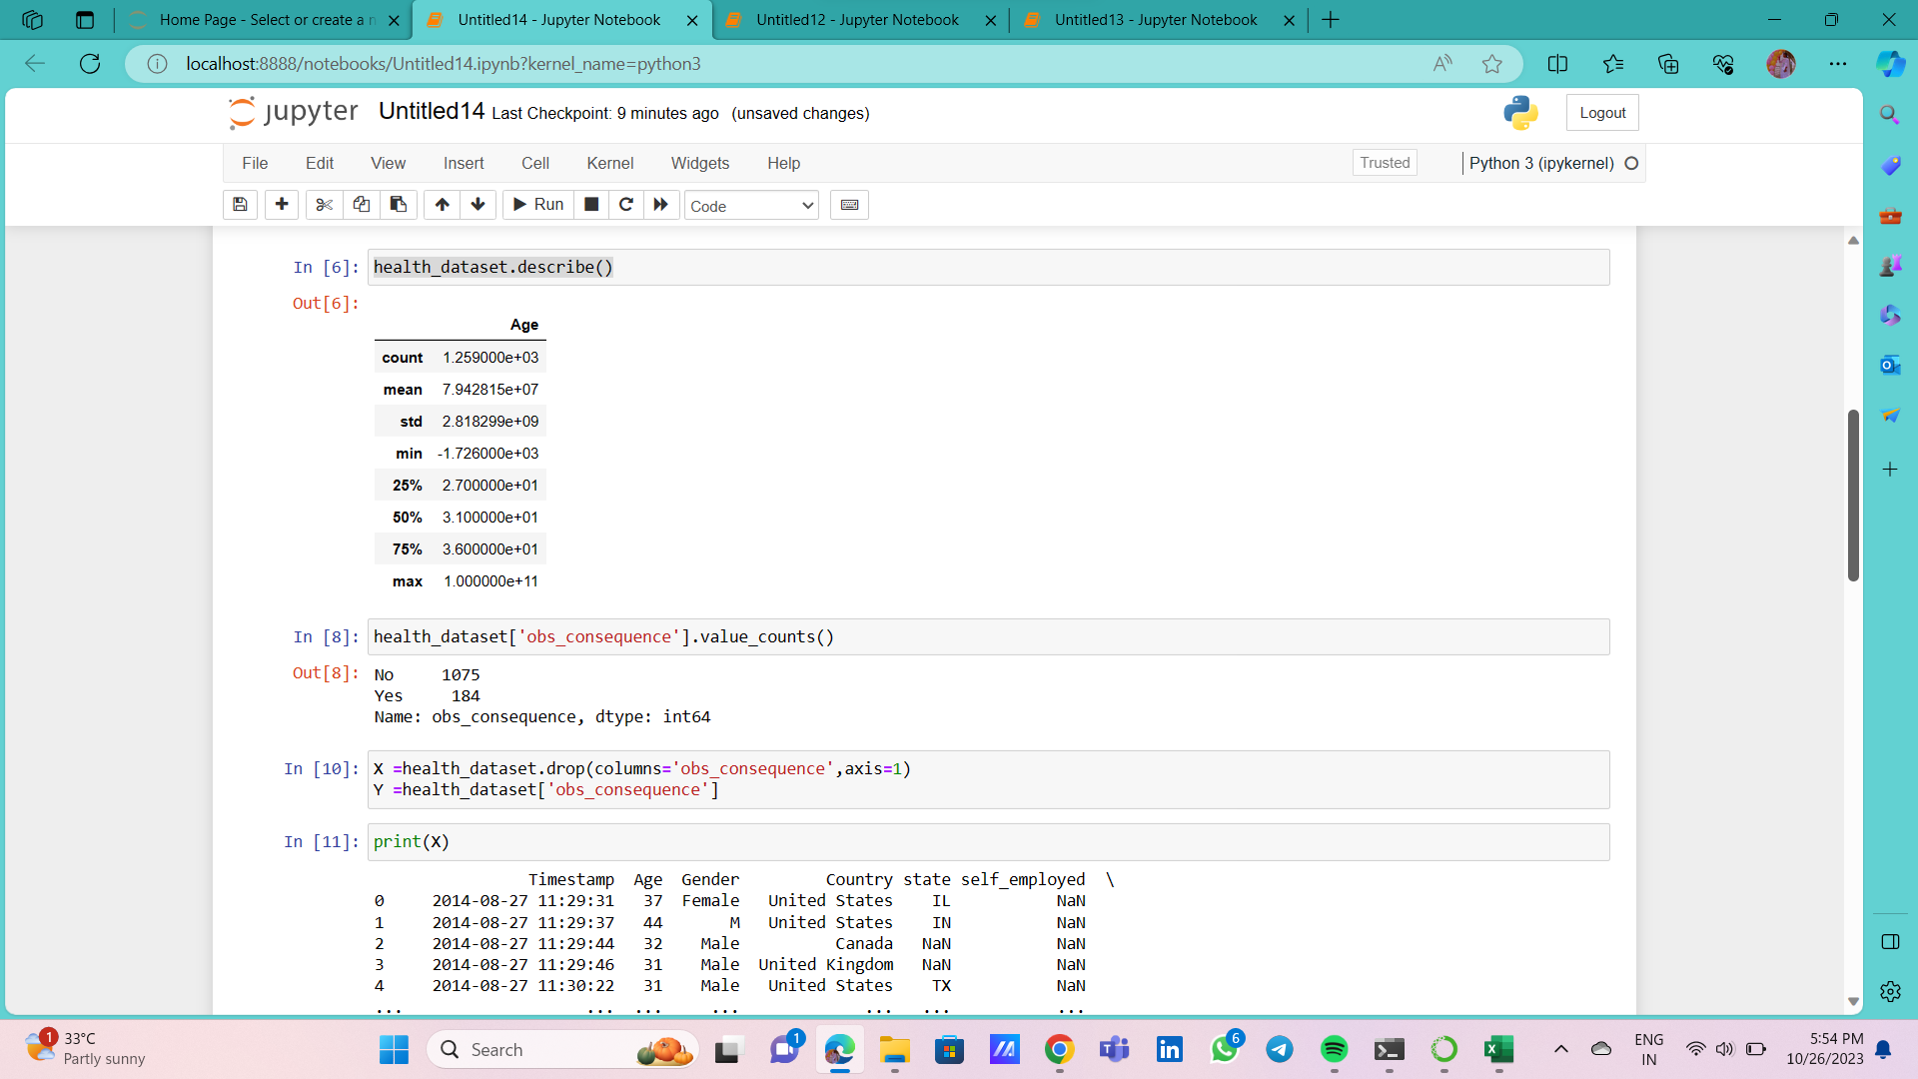

Slide 7
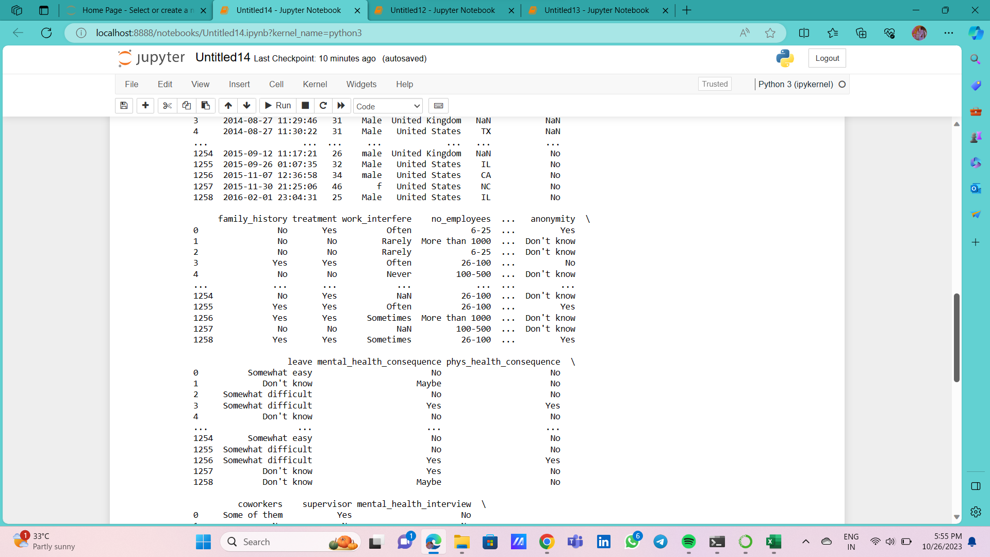

Slide 8
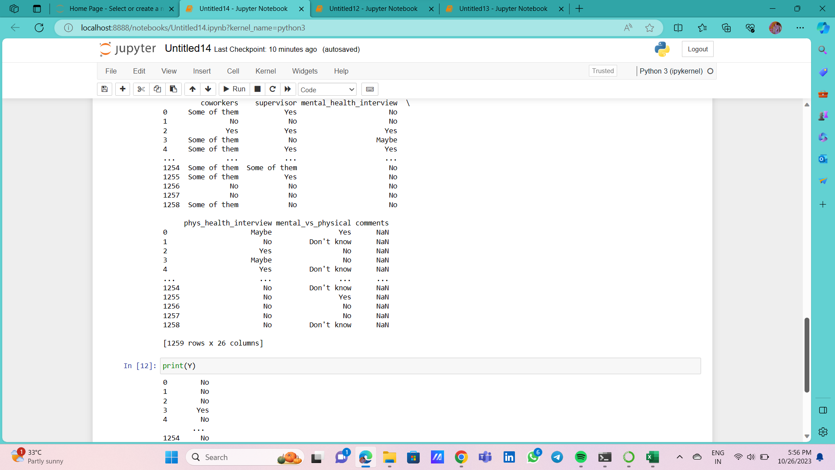

Slide 9
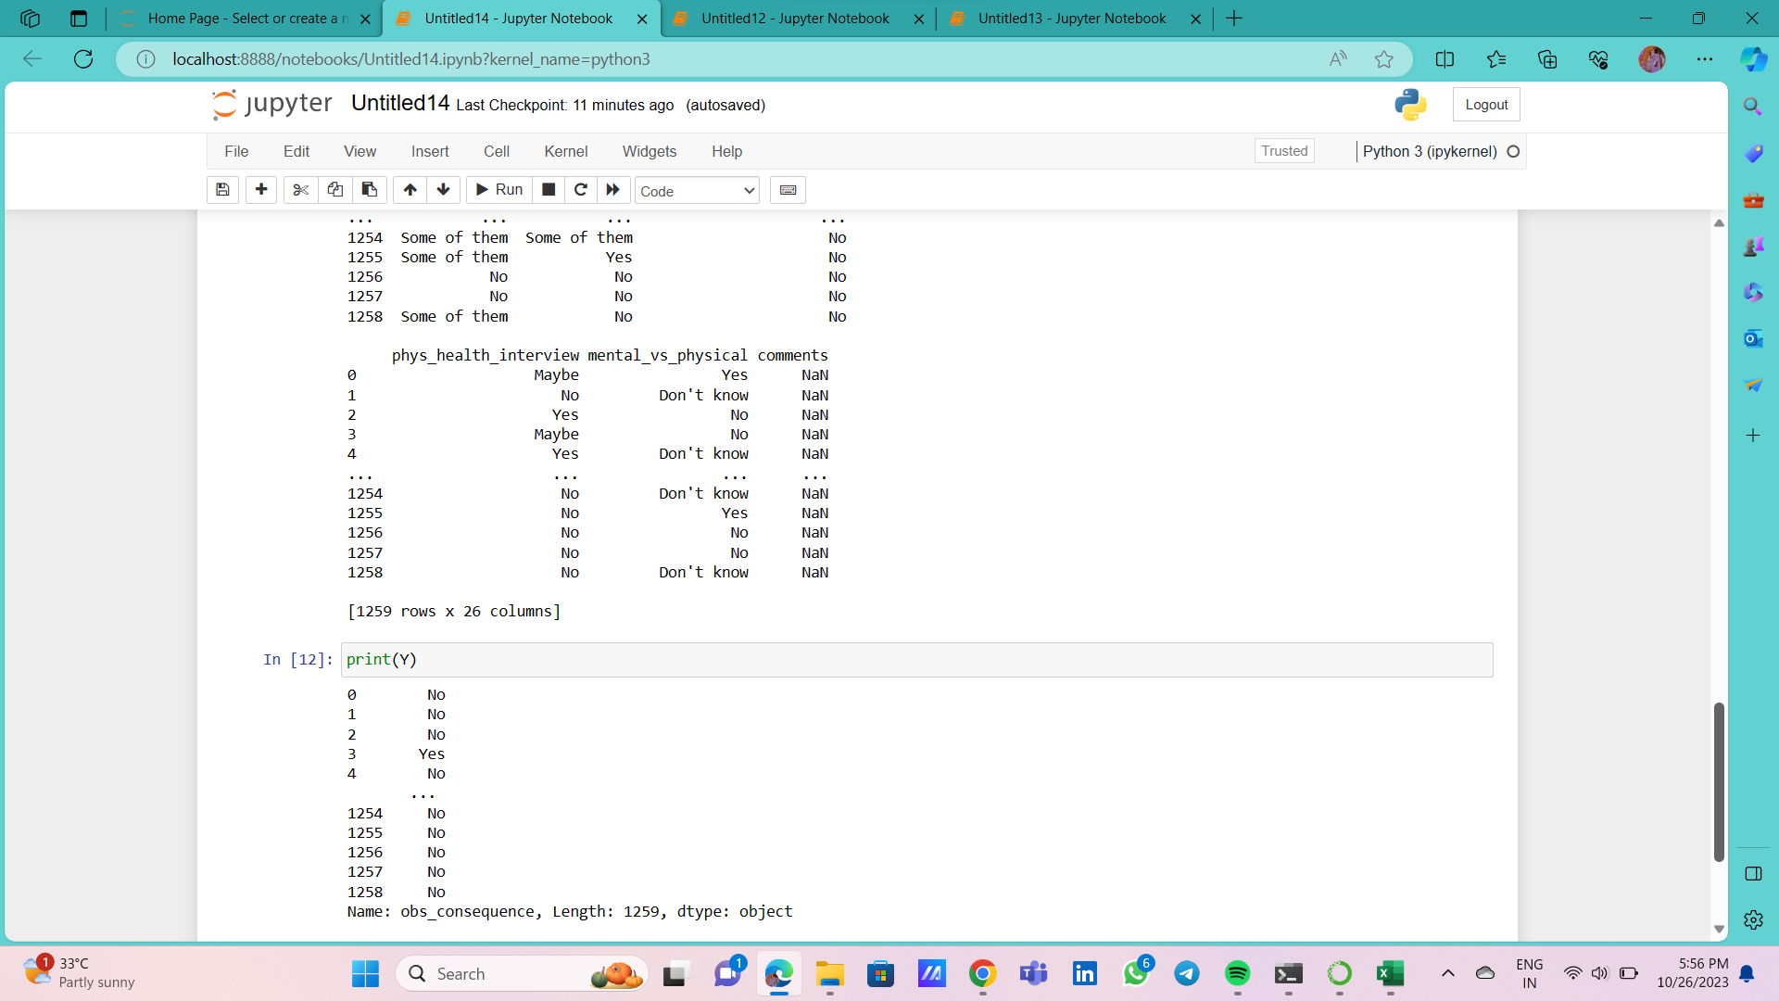

Slide 10
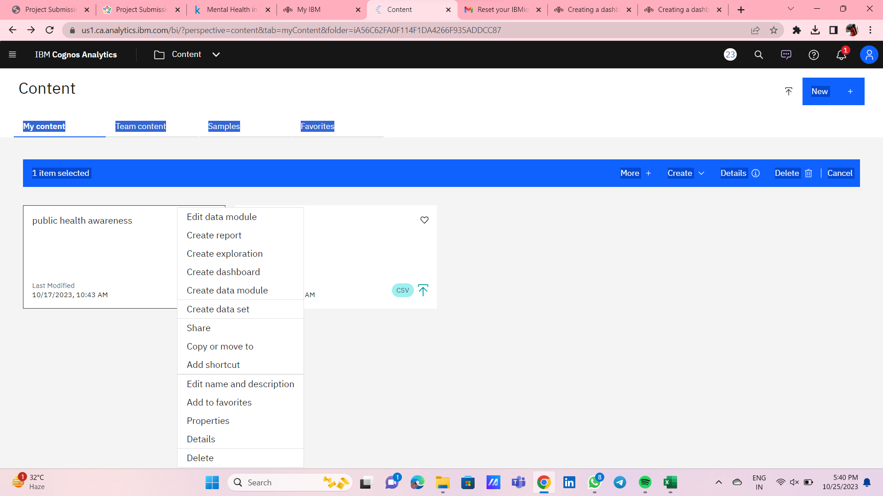
Step 3: CREATING DASHBOARD USING IBM COGNOS

Slide 11
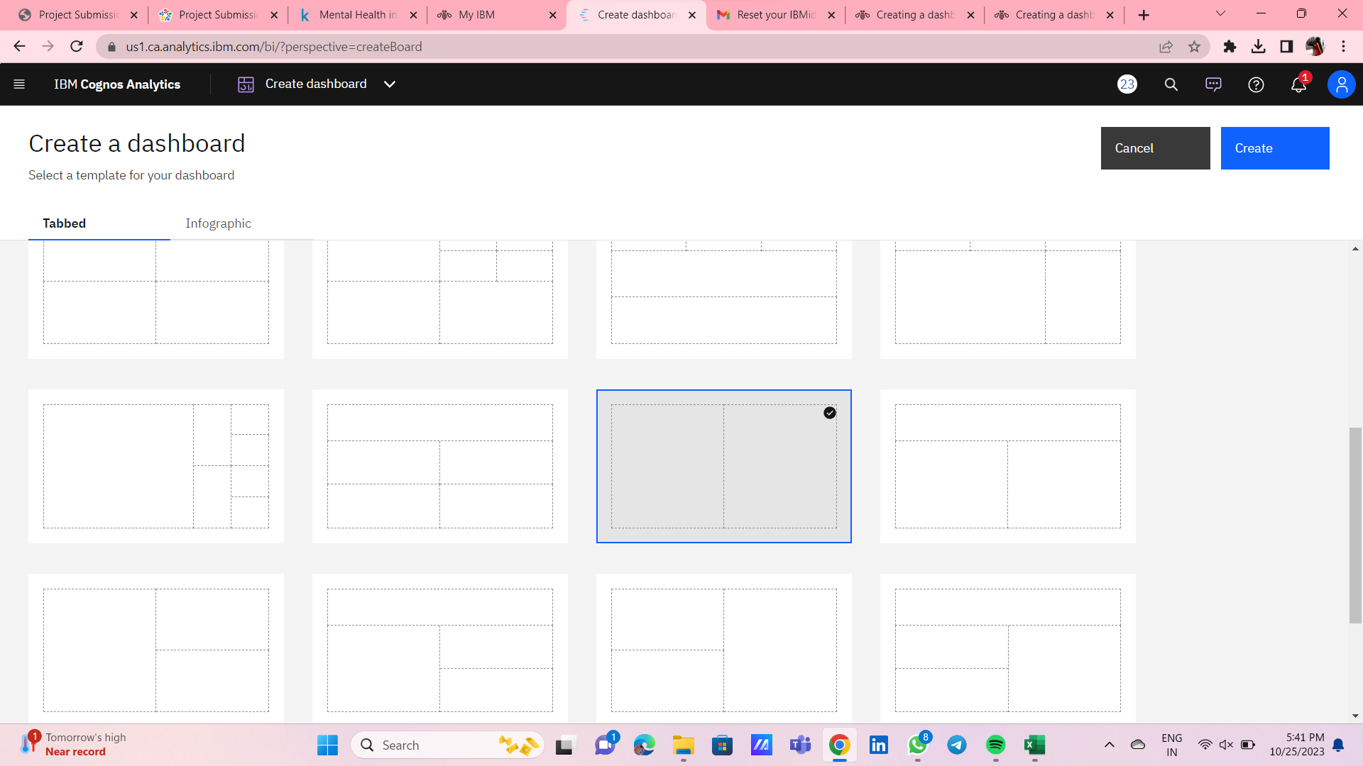

Slide 12
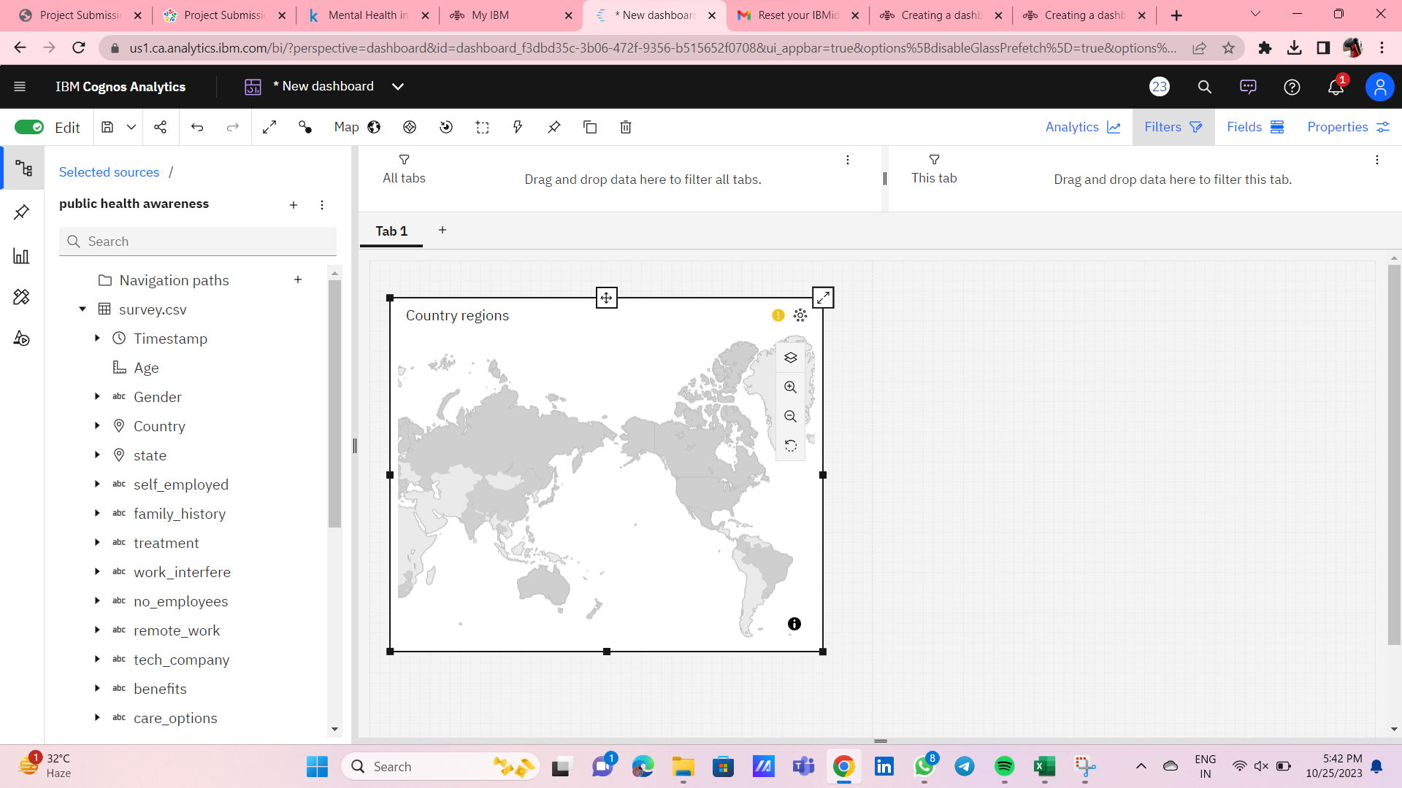

Slide 13
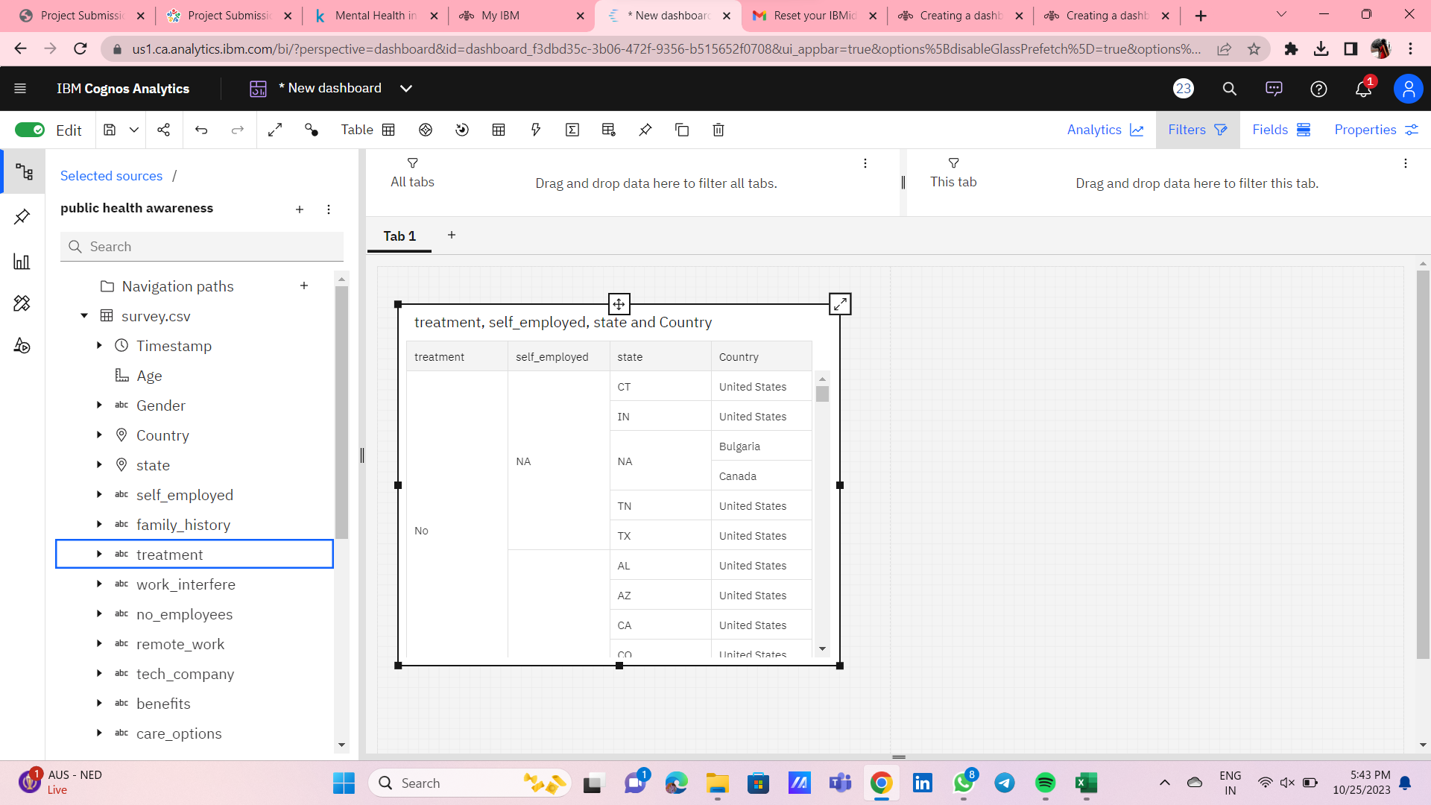

Slide 14
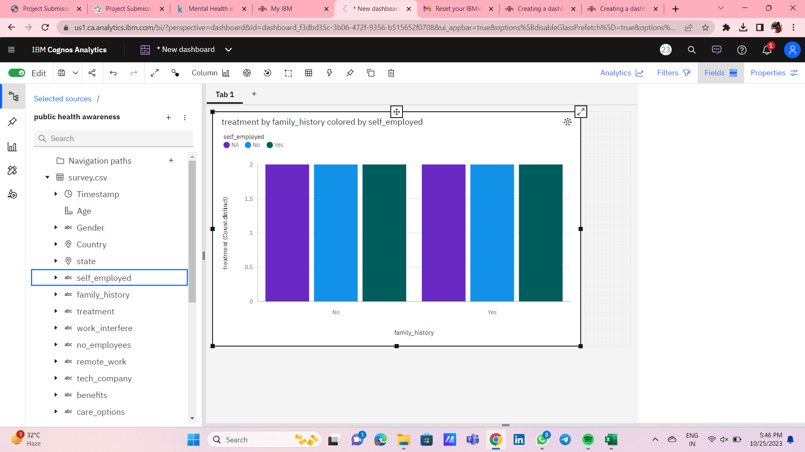
Creating bar graph using dashboard

Slide 15
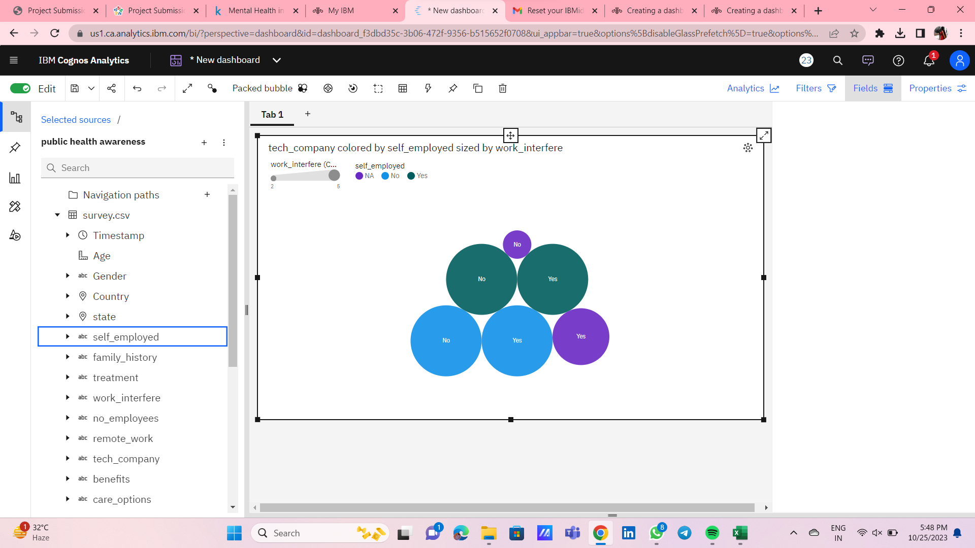
Creating packed ball structure using dashboard

Slide 16
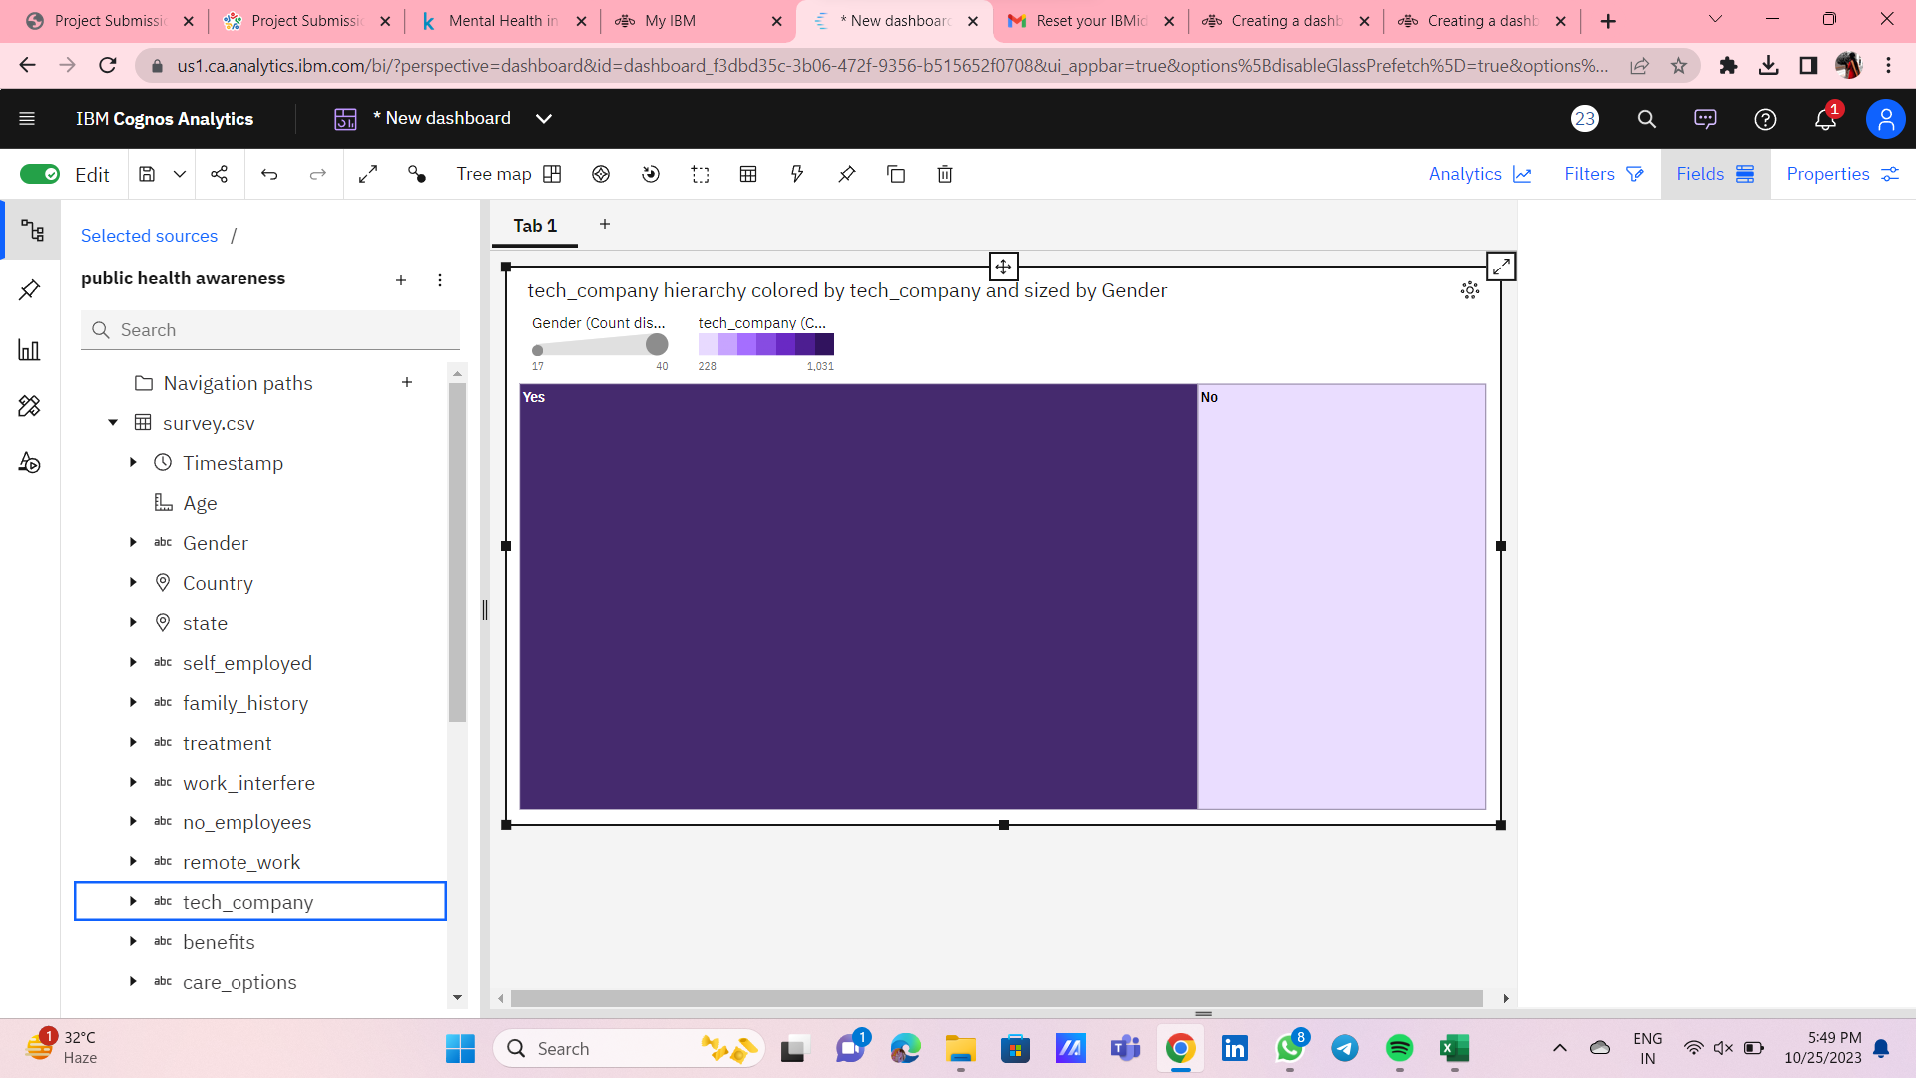
Creating area using dashboard

Slide 17
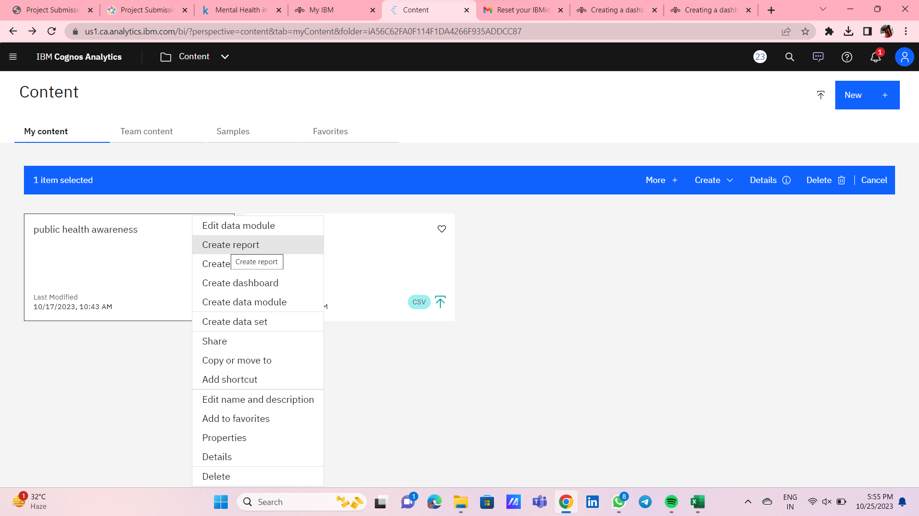
Step 4: CREATING REPORT USING IBM COGNOS

Slide 18
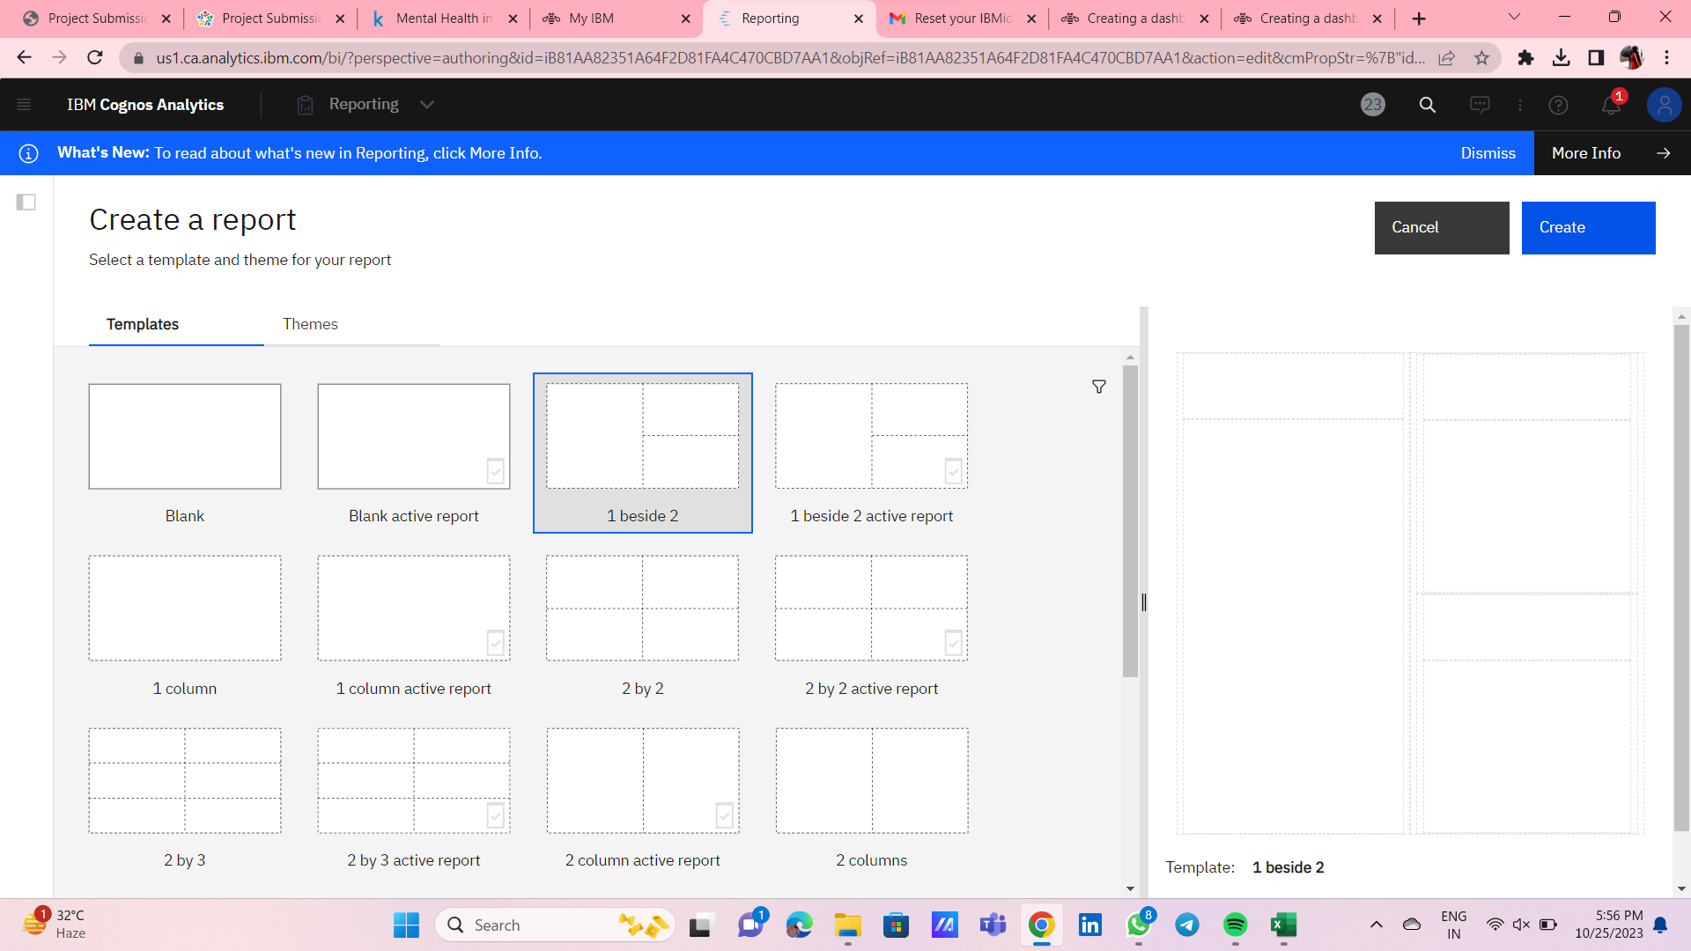

Slide 19
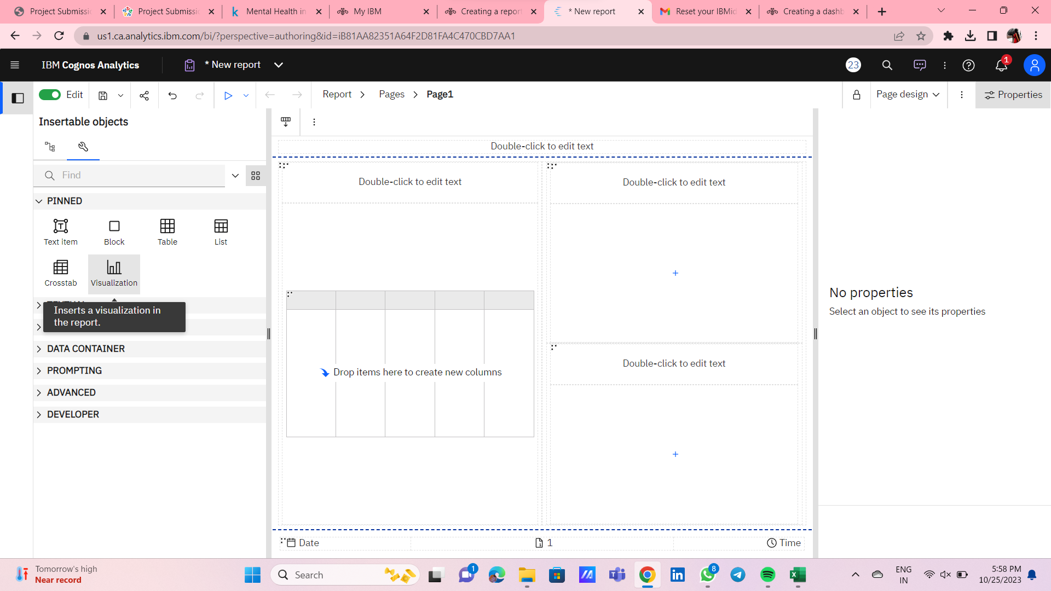

Slide 20
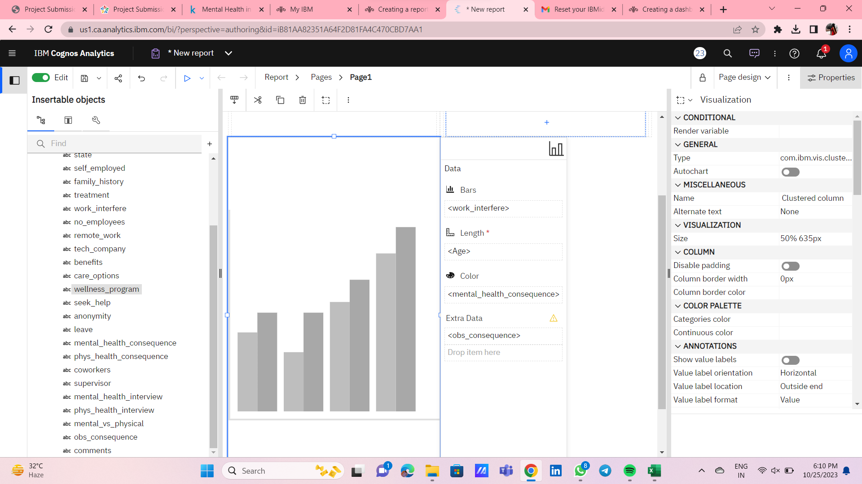
Creating bar graph using report

Slide 21
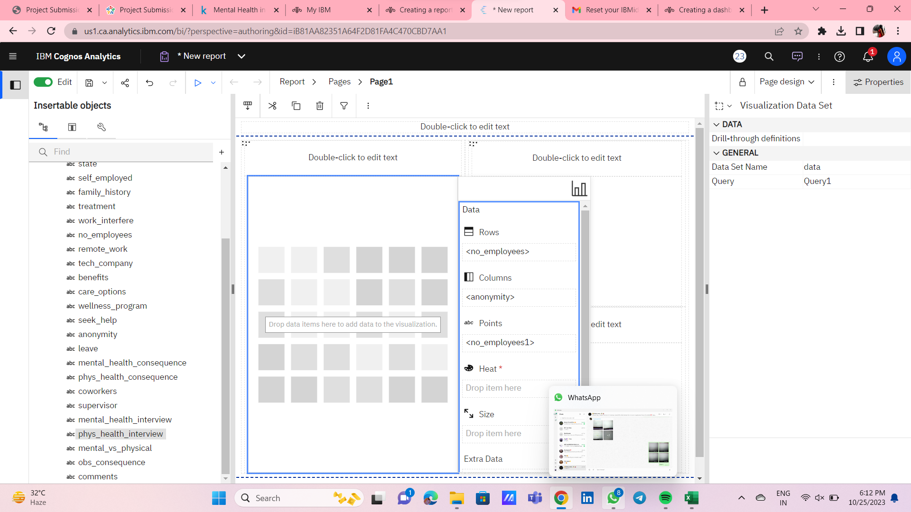

Slide 22
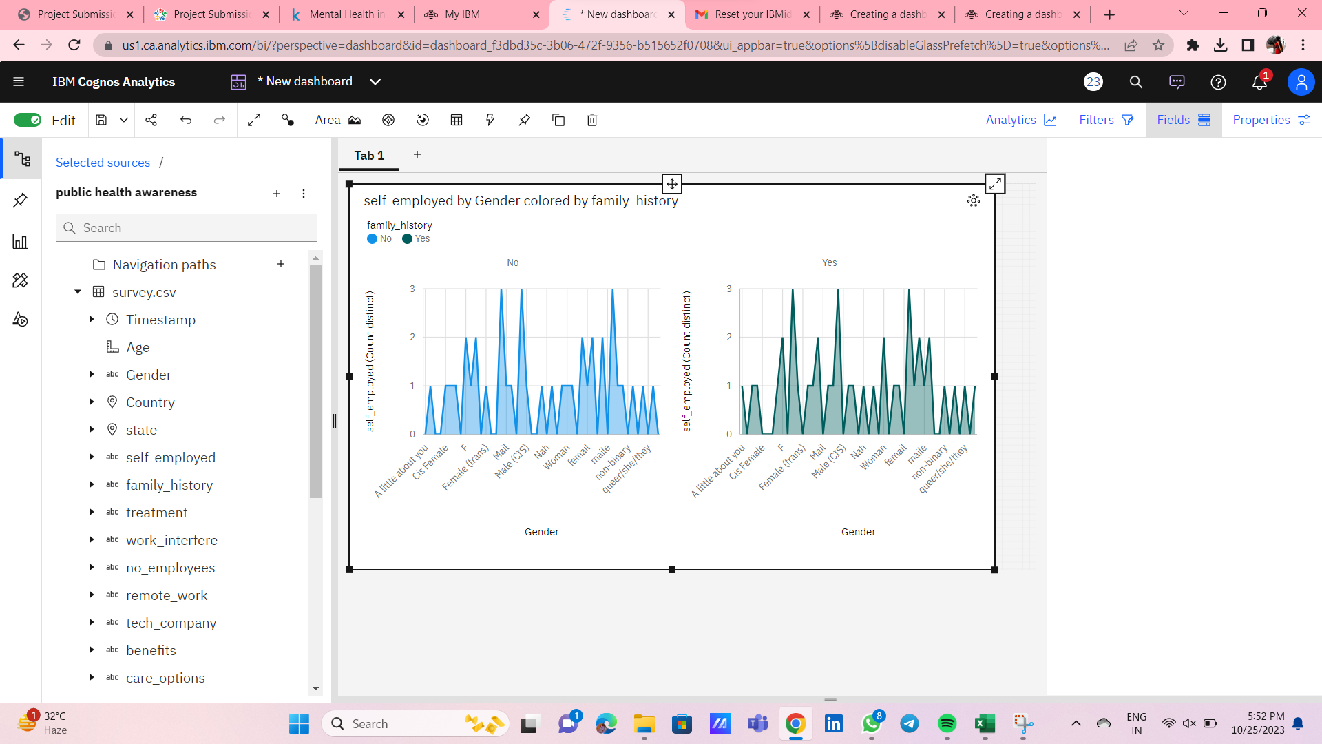
Step 5: STATISTICAL TESTS USING TREEMAP

